Slide 1
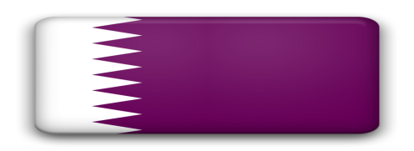
ﻣﺤﻞ ﻋﺒﺪ اﻟﺤﺴﯿﻦ ﻣﺤﻤﺪ اﻟﺨﻮري ABDUL HUSSAIN MOHD.KHOORY STORE
Company Profile
Head Office: Doha, Qatar

Slide 2
AHMKS – An Overview
A family owned integrated sales and marketing company offering a range of FMCG lines (Food and Non-Food).
Established in 1942, AHMKS represent 36 brands spanning 10 categories.
Complete Warehousing, Logistics and Distribution Agency Addressing key retail, Wholesale, Down Market and Institutional segments.
Brand portfolio (food and non-food items).

Slide 3
An Overview (Continue)
Annual Turnover in excess of $43 million US Dollar.
Serving consumer in key Qatar market.
Among the top distribution companies in Qatar with extensive Warehousing and Distribution capabilities.
Distribution network covering Qatar market as, Hypermarkets, Super Markets, Groceries, Traditional food Whole Sellers, Restaurants, Caterings, Hotels, Barbers & Working Camps.
Company Size: Medium.
Number of Employees: 50-100

Slide 4
Platinum Customer(Continue)
Qatar Airways Airline
Government Sector
Minister of Interior
Minister of Health
Minister of Defense
Qatar Foundation Education
Qatar Petroleum

Slide 5
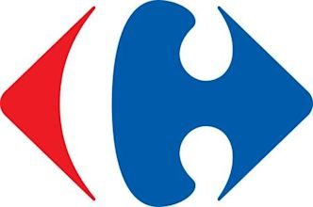
Our Clients
Carrefour
LULU
Safari
Al-Meera
Souq Al-Baladi
Saudia Hypermarket
Spar
Family Food Center
Mega Mart

Slide 6
Key Strengths
Among Qatar active entrepreneurial family companies.
Owned warehousing and logistics - handling incoming Cargo via road, Sea & Air (16000 sq. m size)
Distribution-numeric distribution coverage by sales team, (by channel management) key Retail, Wholesale, Down Market and Institutional , Served by
21 Delivery Truck.
15 Van Sales
8 Sales Rep Car
2 Van Sales (Online)
Advertising and marketing - strong equity for the AHMKS brand supported by sound advertising .
Aggressive brand merchandising team - category management.
Dedicated and Efficient Delivery System.

Slide 7
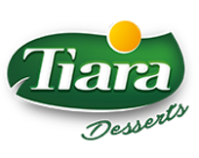
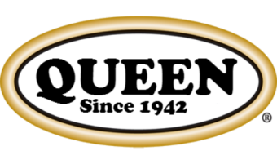
Branded Represented
Quaker Oats
Home Pride
Greens of Brighton
Sipa Pasta
Crespo Olives
Queen Olive Oil
Feather Razor
Lustucru Pasta
Tiara Dessert
Carlos Sun Rice
Golden Phoenix
Imperial Taste
Queen Canned Fish
Majestea
Hermony Soap

Slide 8
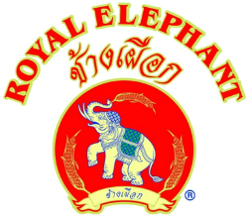
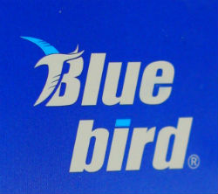
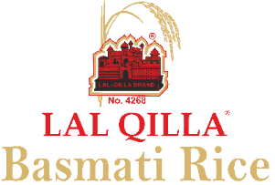
Branded Represented
Diamond G Rice
Golden Lion Vermicelli
Safi Sardine
Maculex
Ever Green Tea
Gold Rose Vermicelli
Royal Elephant Rice
Redsun Brand Rice
Blue bird Blade
Lal Qilla Basmati Rice
Laila Tuna
Nang Sen
Nature’s Charm
Royal Lexi
Caola

Slide 9
Branded Represented
Royal Kimi
Anita Beauty Soap
Lark Beauty Soap
Khoory Rice
Chef’s Choice

Slide 10
AHMKS Product Range
Oats
Rice
Parboiled Rice
Olive Oil
Olives
Canned Fruit
Dumpling Mix
Disposable Items
Wheat
Red Lentil
Sugar
Sun Flower Oil
Honey
Tuna Fish
Cleaning Item
Blades
Flour
Green Pea
Pasta
Camolino Oil
Tea
Jelly
Soaps
Etc…

Slide 11
Distribution and Market Coverage
Key retail outlets covered by 8 sales representatives.
Wholesale market covered by 3 sales representatives.
Down market covered by 5 van salesman.
Institutional sale covered by 2 salesman.
9 brand merchandisers for key retail accounts.

Slide 12
The AHMKS Advantage
80 years experience in FMCG.
Established and Trusted brand name.
Sound understanding of the Qatar market.
Led by a team of highly experienced Qatari entrepreneurs with highly honed business skills.
Extensive Capabilities sand resources in warehousing , logistics and distribution.
The vision to be the best market reach in all segments.

Slide 13
About Qatar
Qatar is a peninsula of 11.437 sq. Km. located halfway down the west coast of the Arabian Gulf. The Emir, His Highness Sheikh Jasim Bin Hamad Bin Khalifa Al Thani, is the ruler of Qatar and is the head of the constitutional authorities, holding both legislative and executive powers.
Oil and gas have given Qatar one of the highest per capita incomes in the world and made it one of the fastest-growing economies. Displaying an enlightened approach to prosperity, Qatar is channeling its wealth not into trophy assets but into funding the advancement of culture, science, and education. Its strategic path towards a post-hydrocarbon economy will be through a vibrant, knowledge-based society.

Slide 14
About Qatar (Cont)
Energetic and ambitious, the State of Qatar has emerged from virtual anonymity to become one of the most forward-thinking nations in the Middle-East, with increasing regional and global influence. Latest estimates put Qatar’s population at more than 1.5 million.
By 2030, Qatar aims to be an advanced society capable of sustaining its development and providing a high standard of living for all of its people. Qatar’s National Vision defines the long-term outcomes for the country and provides a framework within which national strategies and implementation plans can be developed.

Slide 15
Company Structure
Director
General Manager
Business Head
Sales Manager
Finance Manager
Logistic Manager
Key Account Manager (Retail)
Sales Representative (Retail) 8
Cash Van Supervisor
5 Cash Van Sales
Sales (Wholesale) 3
Institutional 2
Merchandisers 9
Helpers , Forklift Operators and Drivers 50
Accountants 2

Slide 16
Contact Info
Address:
Industrial Area Street No : 2 P.OBox: 175 Doha - Qatar Fax: +947 -460-6477 C.R No : 4866
Head Office Tel: +974-4460-6484
Warehouse Tel: +974-4460-1952
Wholesale Tel: +974-4441-6126
Website: www.khoorystore.com
Key Person
CEO (Business Head)
Mohammed Al-Khoory
Cell: +974-5551-2679
Email: info@khoorystore.com
Manager
Farooq Al-Khoory
Cell: +974-5504-0202
Email: khoory1@qatar.net.qa

